Slide 1
Chapter 6 Congestion Control & Resource Allocation
Gandeva Bayu Satrya (GBS)
gbs@ittelkom.ac.id
gandeva.bayu.s@gmail.com
TELKOM ENGINEERING SCHOOL
Telkom University

Slide 2
Agenda
Chapter 6. Congestion Control & Resource Allocation
Resource Allocation
Queuing Disciplines
TCP Congestion Control
Congestion Avoidance
Quality of Service

Slide 3
Resource Allocation
The process by which network elements try to meet the competing demands that applications have for network resources—primarily link bandwidth and buffer space in routers or switches

Slide 4
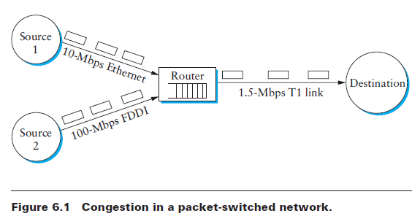
Congestion Control
the efforts made by network nodes to prevent or respond to overload conditions

Slide 5
Resource Allocation Mechanism (Taxonomy)
Router-Centric vs Host-Centric
Routers responsible: forward or drop packet
Host: observe the network condition
Reservation Based vs Feedback Based
Host reserves amount of buffer and bandwidth
Sending data without reserving and adjust data according to the feedback
Window Based vs Rate Based
Window: buffer space, data transmitted
Rate: bit/second network can absorb

Slide 6
Queuing Disciplines
There are three common queuing algorithms:
First in First Out (FIFO)
Fair Queuing (FQ)
Class Based - weight fair Queuing (CB-WFQ)

Slide 7
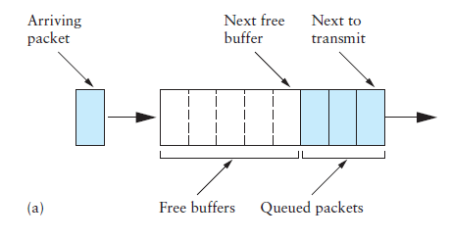
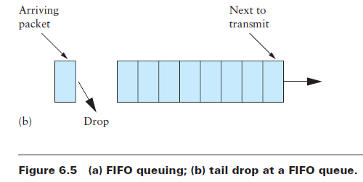
First in First OUT (FIFO)
First in First Out (FIFO)
The first packet that arrives at a router is the first packet to be transmitted

Slide 8
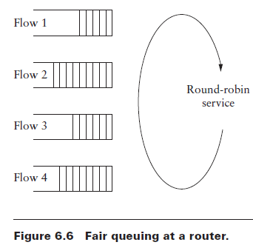
Fair Queuing (FQ)
Fair Queuing (FQ)
The idea of FQ is to maintain a separate queue for each flow currently being handled by the router. The router then services these queues in a round-robin manner.

Slide 9
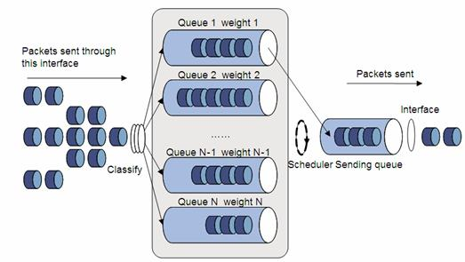
Class Based - Weight Fair Queuing (CB-WFQ)
Variation of FQ that allows a weight to be assigned to each flow (queue).
This weight logically specifies how many bits to transmit each time the router services that queue, which effectively controls the percentage of the link’s bandwidth that flow will get.

Slide 10
Congestion Avoidance Mechanism
There are three different congestion avoidance mechanisms.
DECbit
Random Early Detection (RED)
Source-based Congestion Avoidance

Slide 11
DECbit vs RED
Similiarity:
Each router is programmed to monitor its own queue length. It will give notification when congestion is detected.

Slide 12
DECbit vs RED -- Differences
Mechanism | DECbit | RED
Notification | Setting binary congestion bit in the packet 0 = No congestion 1 = congestion | Dropping one of packets immediately
Packet Dropping | No packet dropping. If packet congestion < 50% then cwnd + 1 If packet congestion > 50% then cwnd – (0.875 x prev packet) | If AvgLen <= MinThreshold → Queue the packet If MinThreshold < AVgLen < MaxThreshold → calculate probability P→ drop packet with probability P If AvgLen >= MaxThreshold → drop packet

Slide 13
Bibliography
Kurose, J.F., and Ross, K.W., Computer Networking : A Top-Down Approach Sixth Edition, Pearson Education, Inc. USA, 2013.
Lammle T., Cisco Certified Network Associate : Study Guide Fifth Edition, Sybex, Inc. USA, 2005.
Peterson, L.L., and Davie, B.S., Computer Networks: A Systems Approach Fifth Edition, Morgan Kaufmann, Burlington USA, 2012.
Tanenbaum, A.S., and Wetherall, D.J., Computer Networks Fifth Edition, Pearson Education, Inc., Boston USA, 2011.

Slide 14
THANK YOU
Gandeva Bayu Satrya (GBS)
gbs@ittelkom.ac.id
gandeva.bayu.s@gmail.com
TELKOM ENGINEERING SCHOOL
Telkom University

